Slide 1
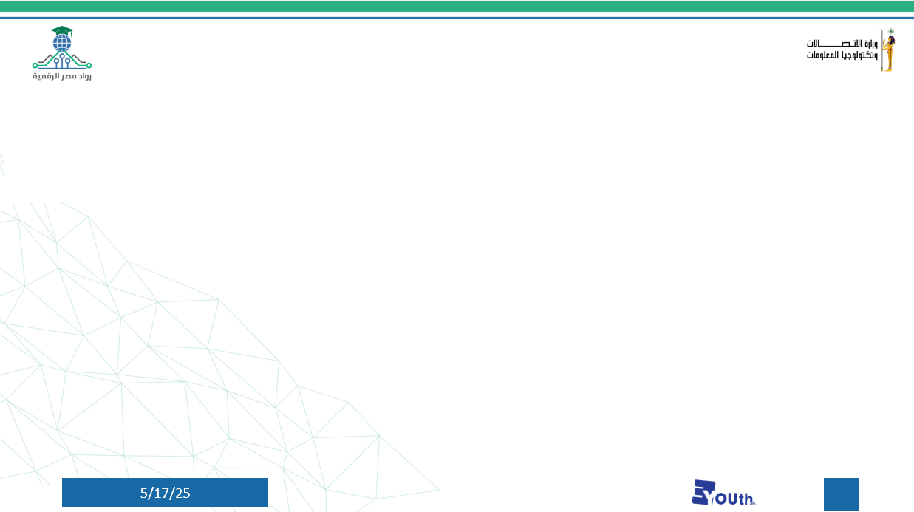


Sales Forecasting and Demand Prediction
by: Nouran Khaled
1

Slide 2

🔹 Brief Description of the Problem Being Solved
Many businesses face challenges in accurately predicting future sales and product demand. This often leads to overstocking, stockouts, and inefficient use of resources, negatively impacting inventory, staffing, and marketing decisions.
Project Overview
🔹 Overview of the Proposed Solution
The proposed solution is a machine learning model that leverages historical sales data to forecast future sales and demand. It uses data preprocessing, feature engineering, and predictive modeling, and is integrated with deployment and monitoring tools for real-time usability.
🔹 Unique Value Proposition
What sets this project apart is its end-to-end approach. It not only builds a predictive model but also includes automated dashboards, live data tracking, and flexibility for various business domains. This empowers decision-makers to act confidently based on data-driven insights.
2

Slide 3
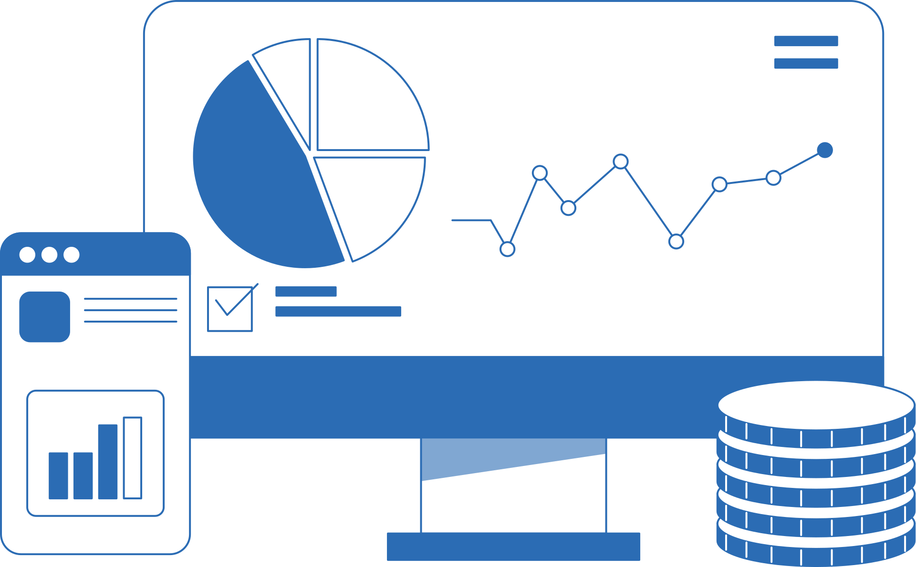
Global Super Store Dataset
Number of Enteries
Number of Columns
Content
Missing Values
The Dataset contains approximately 51,291 entries
The Dataset contains approximately 24 Columns
Details of the orders done online by people across the globe in the time frame 1-jan-2011 to 31-dec-2014.
The dataset doesn’t contain any missing values

Slide 4

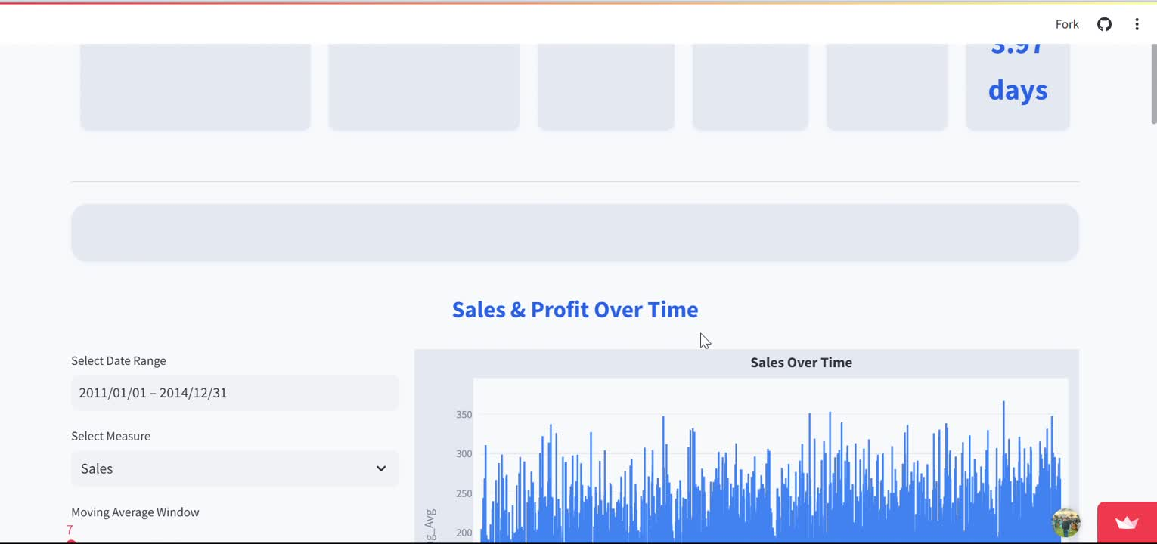
Visual Representation of Key Interfaces
3

Slide 5

End Users and Features
Primary End Users
Small & Medium Business Owners
Need: Accurate sales predictions for inventory and staffing decisions.
Pain Point: Lack of data analysis tools or resources.
Sales Managers & Analysts
Need: Visual and downloadable reports to plan campaigns and set goals.
Pain Point: Manual forecasting and inconsistent historical insights.
Retail Chain Operators
Need: Multi-branch demand tracking and product-level forecasting.
Pain Point: Hard to align supply chain across locations.
4

Slide 6
End Users and Features
Key Features to Address User Needs
Interactive Forecasting Dashboard
Displays real-time sales predictions with filter options by product, region, and time range.
Data Upload & Integration
Supports CSV uploads or API connections to business databases.
Alerts & Insights
Highlights sudden demand changes, seasonal patterns, or underperforming products.
Custom Filters & Forecast Parameters
Users can adjust forecast models based on their own criteria.

Slide 7
End Users and Features
How These Features Solve Real Problems
For small business owners, simplified dashboards and forecasts remove the need for complex analytics teams.
For sales managers, automated reports and visualizations enable faster decision-making and reduce time spent on manual reports.
For retail chains, the platform offers a centralized view of sales across branches, helping optimize inventory distribution.

Slide 8


Data Source & Format
The dataset used is in CSV format, representing historical sales records.
Each row corresponds to a unique transaction, and the data includes:
Order Date, Ship Date, Region, Product, Category, Sales, Quantity, Profit, Discount, Shipping Cost, etc.
Features Overview
Temporal Features: Order Date, Shipping Time (Days), Month, Day of Week, etc.
Categorical Features: Segment, Region, Product Category, Market, Country.
Numerical Features: Sales, Quantity, Profit, Discount, Shipping Cost.
The dataset is relatively balanced, with entries spread across multiple regions and categories
Data Structure
Data Flow
Collection: From sales history CSV or via connected ERP system.
Preprocessing: Cleaning, feature generation, encoding.
Storage: In memory for analysis (or saved into PostgreSQL in production).
Access: Model reads processed features for training and predictions, visualized via dashboard (Plotly, Dash).

Slide 9

Data Processing Techniques Used
Missing Value Handling
Feature Engineering
Encoding
Normalization
Imputation for dates, zero fill for missing cost values.
Rolling Averages (7-day, 14-day)
Lag Features (Profit Lag, Shipping Lag)
Seasonal Components (month, holiday, day of week)
Label Encoding for categorical variables.
Applied for continuous variables to aid model convergence.

Slide 10
Programming Languages + Frameworks
Main Programming Languages Used
Key Frameworks and Libraries
Supporting Technologies
Python
Used for data analysis, preprocessing, model
development, and forecasting logic.
SQL
Utilized for querying and managing structured data
during exploration and potential database integration.
HTML/CSS + JavaScript (via Dash)
For designing interactive and responsive dashboards in
the deployment phase.
Pandas & NumPy – Data manipulation and numerical operations
Scikit-learn – Machine learning model development and evaluation
Plotly & Seaborn – Advanced data visualization
Dash – Building the interactive forecasting dashboard
Matplotlib – Plotting and visual validation
Statsmodels – Time series decomposition and statistical modeling
Jupyter Notebook – For prototyping, EDA, and development
Google Colab / Anaconda – Collaborative or local environment setup
Git & GitHub – Version control and team collaboration
PostgreSQL / CSV – For data storage (current + proposed structure)

Slide 11


Timeline and documentation
Milestones :
Data Collection, Exploration, and Preprocessing
Advanced Data Analysis and Feature Engineering
Machine Learning Model Development and Optimization
MLOps, Deployment, and Monitoring

Slide 12
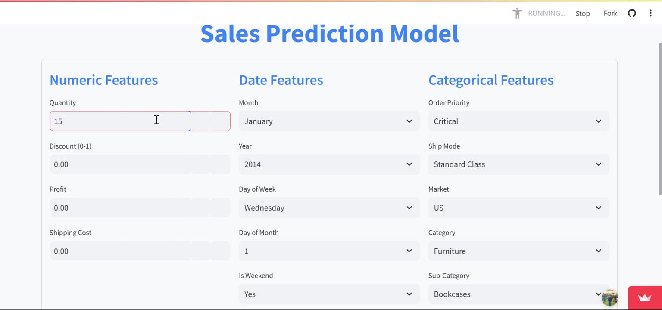
Deployement

Slide 13


Repository
Sales Forecasting and Demand Prediction

Slide 14






Abd El Wahab Mohamed Abd El Wahab
Mohammed Assad Mohammed
Nouran Khaled Ali Wafa
Meet the Team
Mohamed Ramadan Mohamed Radwan
Mohammed Kamal Ahmed
Abd El Azim Reda Rashwan

Slide 15


Slide 16

Thank You
01017428970
Nouran.khaled190@gmail.com
llinkedin: Nouran Khaled

